Slide 1




STAO/OCTE/ACSE
Elementary Science and Technology Curriculum Support
Funding Provided by Ontario Ministry of Education
Notes:
Welcome everyone to the Intermediate webinar.

Slide 2
Land Acknowledgement
The Durham District acknowledges that many Indigenous Nations have longstanding relationships, both historic and modern, with the territories upon which I currently reside. Today, this area is home to many Indigenous peoples from across Turtle Island. I would like to acknowledge that the Durham Region forms a part of the traditional and treaty territory of the Mississaugas of Scugog Island First Nation, the Mississauga Peoples and the treaty territory of the Chippewas of Georgina Island First Nation.
Please take a moment to acknowledge the treaty territory on which you are currently located.
Notes:
Rachel This Land Acknowledgement was made in consultation with local treaty partners. As I am currently on this terrority, I want to honour and respect these treaty partners. I understand that participants have a various range of local treaty partners and are on different treaty territories and without knowing specifically who they are, would like to honour and respect all treaty territories and Inherent Indigenous Rights.

Slide 3

Today’s Presenters: Intermediate Webinar
Nisha Patmanathan - UGDSB
Rachel Cosford - DDSB
Notes:
Both of us

Slide 4

Agenda
Learning Goals
Strand A - Key Changes
Integration of Strands B-E
Long Range Plans
Curriculum Support Resources
Questions and Answers
Survey
Notes:
Nisha
The Agenda for tonight’s webinar is as follows:
First we will go over the learning goals, then talk about the Strand A - key changes, and the integration of strands B-E. Next, we will look at the two models of the long range plans and spend some time going through one of the 4 part curriculum support resources that we have prepared. Finally, we will give you an opportunity to ask questions and have all participants complete a survey.

Slide 5
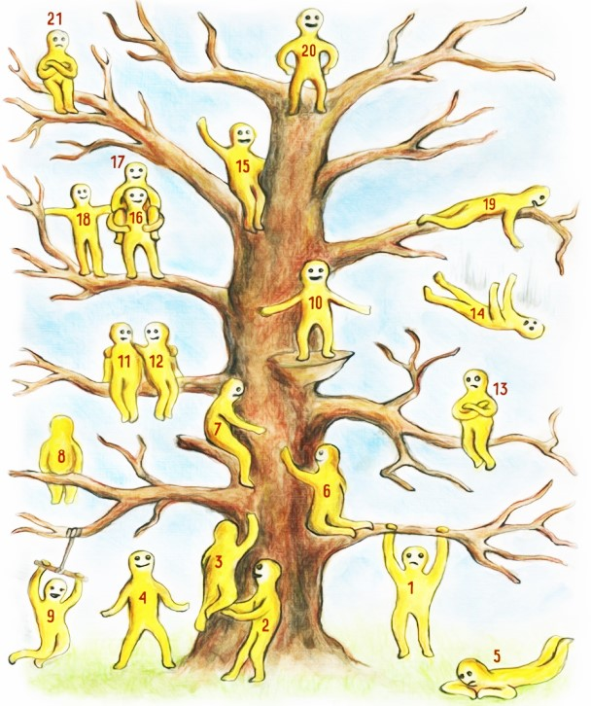
Check-in
Slide
1- Tell us which blob represents how you currently feel about the new Science curriculum.
2- Tell us which blob represents how you would like to feel about the new Science curriculum by the end of the session.
Notes:
Nisha
Source of picture: https://glennlimthots.files.wordpress.com/2016/03/zzz13243.jpg
Explanation of the mind journal: https://themindsjournal.com/choose-a-blob-figure/

Slide 6

Learning Goals
“The 2022 elementary Science and Technology curriculum focuses on hands-on learning in science, technology, engineering, and mathematics, also referred to as STEM, including the application of coding and computing skills. The curriculum includes explicit connections to the skilled trades, technological education and career exploration. Strand A, STEM Skills and Connections, is an overarching strand providing students with the opportunity to investigate concepts and integrate knowledge from each of the other strands through the application of the skills identified in this strand. In turn, students are able to make practical connections between science and technology and other subject areas. Strand A focuses on STEM skills, skilled trades and other STEM-related careers, coding and emerging technologies, practical applications of science and technology, and learning about diverse perspectives, and contributions to science and technology.” Science and Technology
The revised science and technology curriculum includes three main goals:
developing critical skills through scientific and technological investigations
exploring science and technology concepts with a focus on practical connections to student’s lives and communities
considering the bigger picture by making connections between science and technology
and the changing world, including society, the economy, and the environment.
Science and Technology
Notes:
Rachel

Slide 7
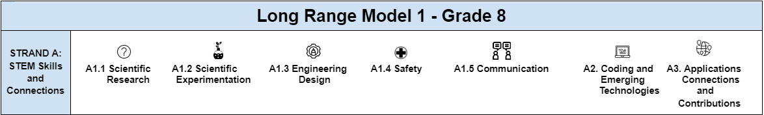
Strand A - Key Changes
Coding and Emerging Technologies
Grades 1 to 3: clear and precise instructions for algorithms, decomposing problems, and testing, debugging and refining solutions
Grades 4 to 6: input, storage, processing, and output
Grades 7 to 8: project management and program design, controlling large systems in action
Coding and Emerging Technologies
Grades 1 to 3: impact of emerging technology and coding on everyday life
Grades 4 to 6: impact of emerging technology and coding on everyday life, including skilled trades
Grades 7 to 8: impact of emerging technology and coding, such as artificial intelligence systems, on everyday life, including skilled trades
Applications, Connections, and Contributions
Grade 1 to 3: practical applications of science and technology in home and community
Grade 4 to 8: practical applications of science and technology in occupations, including skilled trades
Grade 1 to 8: how science and technology can be used with other subject areas to address real-world problems
Grade 1 to 8: contributions to science and technology from people with diverse lived experiences and from various communities
Curriculum and Resources
Notes:
Rachel The top is a clip right from the LRPs that shows one of the key changes to the new science curriculum. As you can see, the entire LRP falls under the umbrella of Strand A which include Scientific Research, Scientific Experimentation, Engineering Design, Safety, Communication, Coding and Emerging Technologies and finally Application Connections and Contributions. The boxes show the specific examples pulled right from the website that go through the specific changes from grades 1 to 8.

Slide 8
Key Changes - Strand A
Curriculum and Resources
Topic | 2007 Curriculum | 2022 Curriculum
STEM Investigation and Communication Skills | Curriculum expectations related to the following were included and repeated in all four strands: scientific research scientific inquiry/experimentation technological problem solving safety procedures communication | Curriculum expectations related to the following are included in this overarching strand A: scientific research scientific experimentation engineering design process health and safety procedures communication
Coding and Emerging Technologies | No references to coding | Grades 7 to 8: input, storage, processing, and output
 | No references to emerging technology | Grades 7 to 8: use research, experimentation or an engineering design process to conduct investigations and explore the contributions that people with diverse lived experiences have made to science and technology
Applications, Connections, and Contributions | No references to practical applications of science and technology concepts | Grade 4 to 8: practical applications of science and technology in occupations, including skilled trades
 | No references to cross-curricular application of science and technology | Grade 1 to 8: how science and technology can be used with other subject areas to address real-world problems
 | No references to contributions to science and technology | Grade 1 to 8: contributions to science and technology from people with diverse lived experiences and from various communities

Slide 9
Key Changes - Strand B-E
Curriculum and Resources
Strand | 2007 Curriculum | 2022 Curriculum | Program Planning, Cross Curricular, Integrated Learning in Science & Technology
Strand B | Grade 7: Interactions in the Environment Grade 8: Cells | Grade 7: Interactions in the Environment Grade 8: Cells | Science and Technology content: Health and Safety Coding and the Impact of Coding Emerging Technologies Skilled Trades Climate Change Food Literacy
Strand C | Grade 7: Pure Substances & Mixtures Grade 8: Fluids | Grade 7: Pure Substances & Mixtures Grade 8: Fluids
Strand D | Grade 7: Form & Function Grade 8: Systems in Action | Grade 7: Form, Function & Design of Structures Grade 8: Systems in Action
Strand E | Grade 7: Heat in the Environment Grade 8: Water Systems | Grade 7: Heat in the Environment Grade 8: Water Systems
Notes:
Food insecurity relevant to our current society ( high cost of food and connections to climate change )

Slide 10

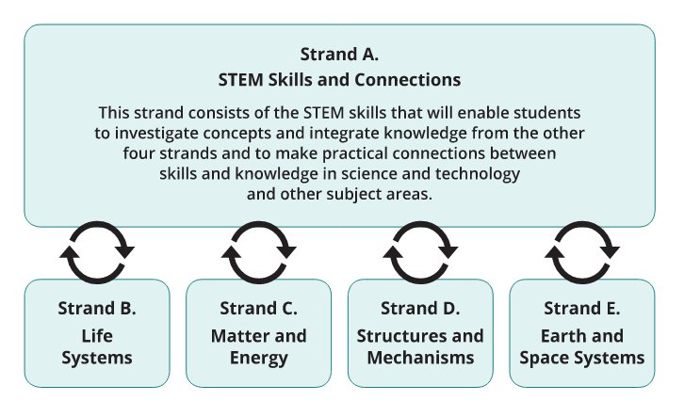
Integration of Strands B to E
Notes:
Nisha
Strand A focuses on the STEM skills that enable students to explore and investigate concepts. Students apply these skills as they integrate knowledge from the other four strands and as they make connections between these skills and knowledge and real-world issues in science and technology as well as other subject areas.
In this strand, students use scientific research, scientific experimentation, and engineering design processes to carry out formal investigations, design solutions to problems, and communicate their findings. Students also learn how to follow established health and safety procedures.
Students gain an understanding of the technology they use every day and use coding in investigations and to model science and technology concepts. In addition to using coding, students assess the impact of coding and of emerging technologies on everyday life and in STEM-related fields.
Students can learn about Indigenous sciences and technologies, and make connections to First Nations, Métis, and Inuit knowledge systems and perspectives, helping them assess the impacts of discoveries and innovations on First Nations, Métis, and Inuit communities. They can also investigate the scientific and technological knowledge systems and perspectives of various cultures, analyse the contributions of people with diverse experiences, and describe practical applications of science and technology.

Slide 11
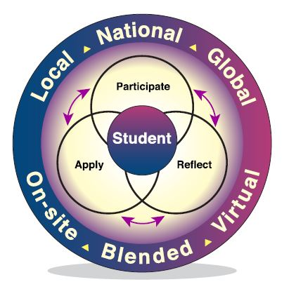
Experiential Learning
Experiential learning is hands-on learning that occurs in person or virtually and provides developmentally appropriate opportunities for students of all ages to:
participate in rich experiences connected to the world outside the school;
reflect on the experiences to derive meaning; and
apply the learning to their decisions and actions.
Notes:
Nisha
Experiential Learning provides students with the opportunity to become absorbed in their learning as they participate in an activity, to reflect on their experiences while participating and then applying what they have learned to their lives.
Experiential learning opportunities that are connected to various aspects of the curriculum help students’ gain better knowledge of themselves and of a range of career opportunities available. There are two areas of learning outlined in Creating Pathways to Success: An Education and Career/Life Planning Program for Ontario Schools – Policy and Program Requirements, Kindergarten to Grade 12, 2013. The link will be provided in the chat box. http://www.edu.gov.on.ca/eng/document/policy/cps/CreatingPathwaysSuccess.pdf
When providing experiential learning opportunities, educators should ensure that the experiential learning cycle (participate, reflect, apply) is a planned part of the experience.
Some examples of planned learning experiences in the community may include outdoor education, project/program-based learning, job shadowing and job twin­ning, field trips, field studies, work experience, and cooperative education. These opportunities allow students to see the relevance of their classroom learning and its connection to the world. Additionally, they may also assist students in developing transferable and interpersonal skills and work habits that prepare them for their future. This will enable students to dive into careers of interest as they plan their pathway through school to their postsecondary destination, whether in apprenticeship training, college, community living, university, or the workplace.
The new curriculum includes hands-on, experiential learning opportunities to support classroom activities to nurture and spark curiosity and wonder.

Slide 12





Long Range Plans - An Overview
Grade 8 Long Range Plan Model 1 | Ontario Elementary Science Curriculum
Strand A:
Strand B: Life Systems
Strand C: Matter and Fluids
Strand D: Structures and Mechanisms
Strand E: Earth and Space Systems
September/ October Big Idea: Water - Economic, Social and Environmental Impacts
Cross Curricular Connections:
Geography
History
Mathematics
Language
Skilled Trades
Resources:
Links to specific activities, extensions, lesson plans, articles, videos, etc.
Notes:
Rachel There are two models for teacher preference and both include the same information, just follow a different format and layout. Rather than LRP plans that go strand by strand, these LRPs center around Big Ideas. For example, in the grade 8 LRP, the first Big Idea is around Water, more specifically, economic, social and environmental impacts to our water systems. Each Big Idea includes guiding questions to help teachers and students in their understanding of the topic. Strand A is the overarching strand and is evident in each Big Idea. The icons are helpful visuals to connect to the specific expectations. As mentioned, we are encouraging teachers to hit strands at various points, and multiple points, throughout the school year. For this particular Big Idea, the STEM activities suggested to align with Strand A also connect with Strand B….The STEM activities outlined in the Strand A column also connect with the following other subjects: Geography, History, Math, Language and Skilled Trade with suggested extensions and activities for both. You’ll notice that some other Big Ideas have connections to the Arts as well. The final column in the LRP has links to all of the external resources to help support understanding of the activities suggested in this LRP.

Slide 13
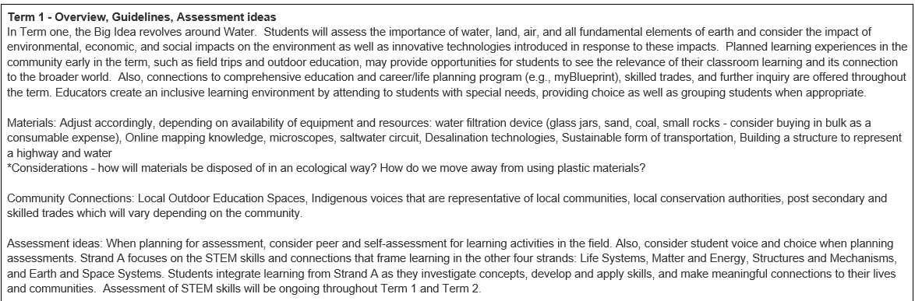
Long Range Plan – Model A
Notes:
Model A includes an Overview to help with planning. This includes suggested prep for materials, ideas for outdoor education and assessment practices.

Slide 14
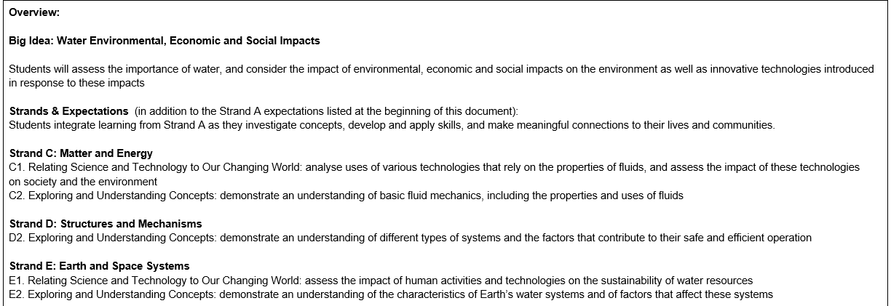
Long Range Planning – Model B
Notes:
Model B follows a different structure with including the Big Idea, strands and expectations as the overview. First steps and next steps are where teachers can find the suggestions for prep of materials, outdoor education and specific examples to support learning.

Slide 15

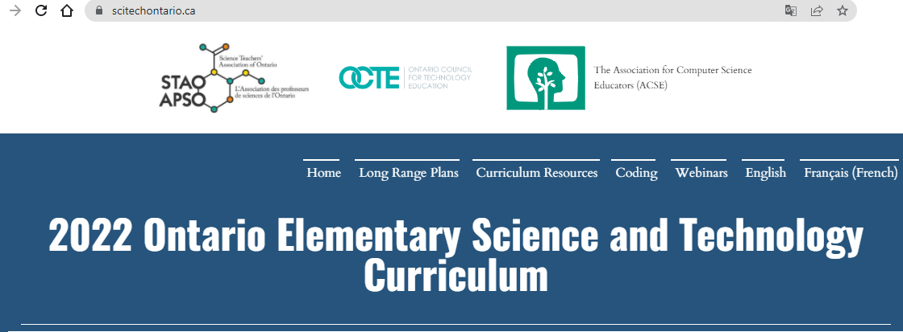
Curriculum Resources - Location
Where to find these resources
Notes:
Rachel - Where to locate resources on the website

Slide 16
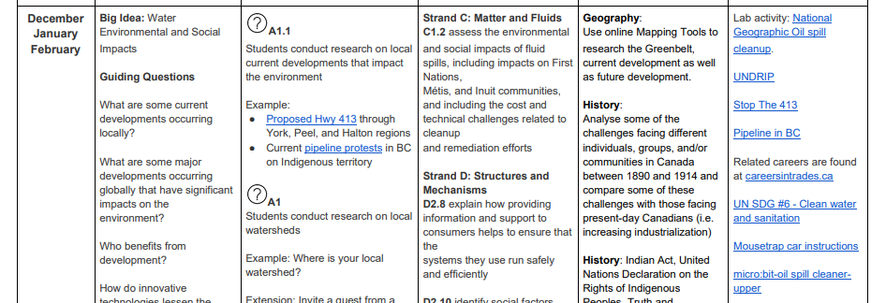
Big Idea: Water - Environmental & Social Impacts
The segment of the LRP - the activities align with this…
Notes:
Rachel - The activities that we are referring to next connect back with the LRP
The activity we’re about to look at aligns with this part of the LRP model A or model B. So we will be looking at Water: environmental and social impacts.In the LRPs, you will find the targeted expectations in Stand A, strand C and D. Along with a description of potential connections and interesting resources.

Slide 17







Curriculum Resources - Examples
Specific Examples
Connect to LRP Model
An example; a modifiable 4-part lesson:
Part 1: Research + Global goals
Part 2: Wet lab
Part 3: Application + Engineering design process
Part 4: Coding + Making connections
Notes:
Nisha
The example we will share is a 4 part STEM-focused lesson that touches upon many of the aspects of the new curriculum and designed with 21st century learning in mind. Although this activity Is readily available for you to use, we're hoping this example will inspire you to create your own activities incorporating the new elements discussed earlier relation to the new curriculum.
Notice the icons as they reflect what skill/ strand A expectation is targeted for each part.
Part 1 introduces the students to the United Nations’ Global goals; they will conduct a research and build on their social and communication skills.
In Part 2, There's a focus on the scientific process as the students conduct a wet lab.
In Part 3, students will conduct apply their Knowledge and Skills to analyze a case study. they will also get to go through the engineering design process to build a model.
In the final part, Part 4, students have fun coding as they chose to highlight an environmental or social issue related to water.
They do not have to do all the activities. Educators can pick and choose what they want to do.

Slide 18
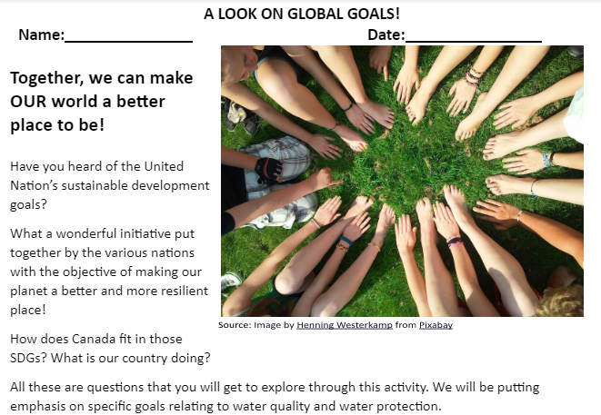
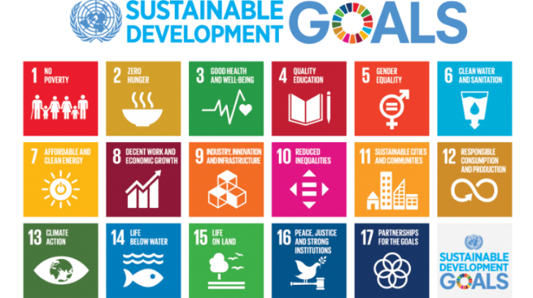
Experience 1 - Exploring UN’S SDG
Source: Source: https://www.un.org/en/sustainable-development-goals
Notes:
Nisha
Part 1 - Exploring the United Nations’ SDGs starts with some questioning; there are examples of some questions that the students can be asked to stimulate critical thinking. They go on to watch a video put together by United Nations explaining the sustainable development goals. The students will then be separated into groups and will explore specific goals centered around water, it's accessibility and its quality. The activity suggests chart paper but other modes of presentations can be used to encourage students to communicate their findings with class their classmates.

Slide 19
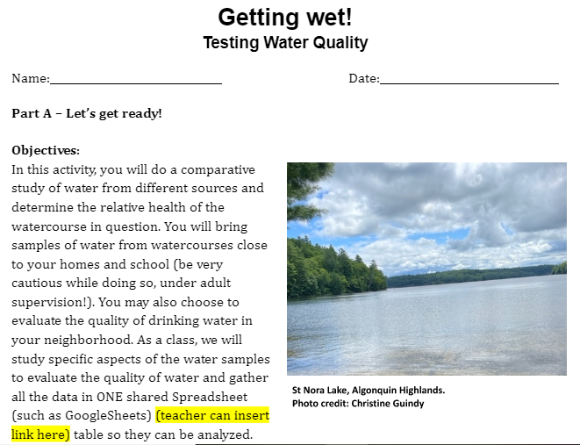
Experience 2 - Testing Water Quality
Notes:
Nisha
Part 2 consist of a wet lab. This is where we students will go through the scientific process, collect water samples, evaluate the quality of the samples, compare them to Ontario standards of water quality and share their findings on a common spreadsheet. Google Sheets is suggested but the teacher can you use another tool that allows students to input all their data in one place.

Slide 20
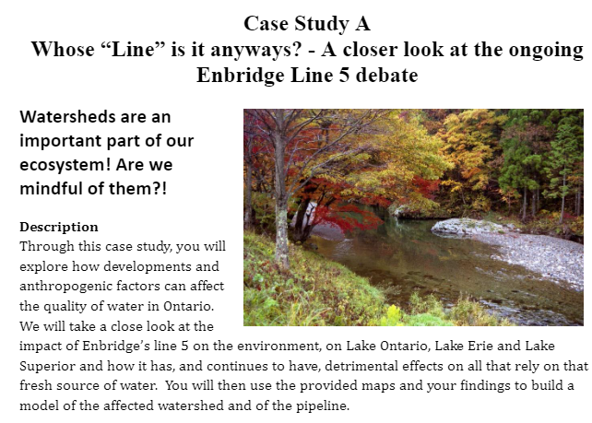
Experience 3A - Case Study
Notes:
Rachel - Student voice and choice - how do we make learning relevant to them?
Part 3 is a case study. here there are two options and students can choose to analyze the ongoing debate surrounding Enbridge line 5 or the ongoing debate around the construction of Highway 413. The students explore the pros and cons of each development, its impact on the surrounding watersheds and the detrimental effects on all that rely on that fresh source of water, and the importance of taking the proper side. The activity ends with the building of a model of impacted watersheds in which the students will suggest alternative Solutions. This is a good opportunity to discuss the engineering design process as they go through building of the model and there's a shared presentation later on that is ready to use for that effect.

Slide 21
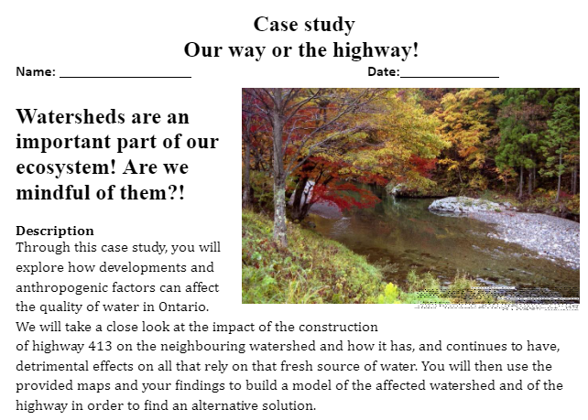
Experience 3B - Case Study
Notes:
Rachel - Here is a screenshot of the Highway 413 case study. Students don't have to do both cases, they just need to select one based on what is relevant to them and the area they live in.

Slide 22
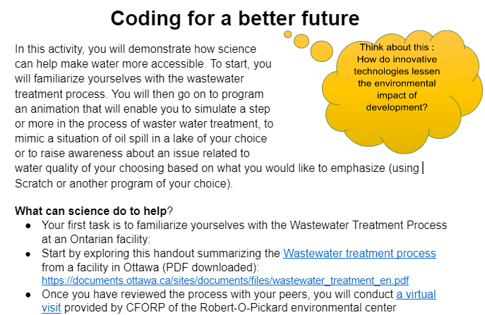
Experience 4: Coding!
Notes:
Finally for this last part, students get to have fun coding. They have options of programs and options of tasks. They can choose to create a program to raise awareness about an issue related to an aspect of this study surrounding the environmental and social impacts with relation to water quality and availability. They can also chose to create a program simulating either a step or multiple steps in wastewater management or treatment OR mimic a situation of water pollution such as an oil spill. Although Scratch is suggested for this task, there are many alternative coding programs that the students can use based on their level of comfort, that of the teacher and availability.

Slide 23

Ready to use interactive presentations
Notes:
This interactive presentation will also be shared. It is designed in such a way as to allow the students to go through the various steps of the engineering design process in relation to the building of the Watershed. They get to understand the steps involved in the process before building the model. The teacher may choose to use this tool to teach the class in general or can provide it the students and they can go through the steps together in their own groups.
This concludes the content part of our webinar for today.

Slide 24
Writing Teams - Long Range Plans
Primary Team Alison Morawek Amanda Williams-Yeagers Margit Alberti Paula Trainor Megan Bartlett Louise Vaillancourt Philomena Bonis Naomi Martin | Junior Team Adel Chehouri Nisha Patmanathan Mike Kumbhani Gail Mills Ian Ducharme Neelu Singh Tanya Kroocmmo Jean-Pierre Saab | Intermediate Team Rachel Cosford Jane Moodey Pia Eastwood Krista Winters Matthew Nephin Greg Ryerson
Notes:
Nisha - We would like to extend our thanks to the following educators who contributed to the creation of the Long Range Plans.

Slide 25
Writing Teams - Curriculum Resources
Primary Team Francesca Flood Joanna Strickland Justine Montgomery Katelyn Scott Junior Yolanta Krawiecki Michelle Li | Junior Team Erin Coulson Manprit Rai Louise Vaillancourt Ingrid Carlaw Stephanie Stagg Thava Thavarajah | Intermediate Team Christine Guindy Jake Jouppi Michael Frankfort Linda Boucher Sarah Sölter Vanessa Quidayan
Notes:
Nisha - We would like to extend our thanks to the following educators who contributed to the creation of the Learning Experiences and Curriculum Resources.

Slide 26
Writing Teams - Coding Resources
Coding Resources Peter Beens Grant Hutchison Ryan Smith Shamaila Aslam
Notes:
Nisha - We would like to extend our thanks to the following educators who contributed to the creation of the Learning Experiences and Curriculum Resources.

Slide 27



Question and Answer
Long Range Plans
Lesson Plans
General Questions
2022 Ontario Elementary Science and Technology LRP
How might student voice be integrated?
Notes:
Rachel - Question for clarification:
Possibilities for Q&A: Participants take 5 minutes to look at long range plans for their grade and come back with a question. Participants take 5 minutes to look at lessons for their grade and come back with a question Participants compare LRP 1 and LRP 2, speak about first impressions regarding differences between models and which one might best suit their students? Please send your questions around how student voice can be integrated to the website on the last slide.

Slide 28


Follow Up Support
What additional supports do you need in order to feel more comfortable with the implementation of the new Science & Technology curriculum?
If you have questions after this webinar has concluded, please email your them to: info@stao.ca
Notes:
Nisha - At this time, we would like to hear from you. What additional supports do you need in order to feel more comfortable with the implementation of the new Science & Technology curriculum?
If you have questions after this webinar has concluded, please email your them to: info@stao.ca

Slide 29
Thank You!
https://scitechontario.ca

